Slide 1
MongoDB Operators
By Arjun Raj

Slide 2
MongoDB Operators
Comparison Operator
Logical Operator
Element Operator
Evaluation Operator
Geospatial Operator
Array Operator

Slide 3
Comparison Operators
Name | Description
$eq | Matches values that are equal to a specified value.
$gt | Matches values that are greater than a specified value.
$gte | Matches values that are greater than or equal to a specified value.
$in | Matches any of the values specified in an array.
$lt | Matches values that are less than a specified value.
$lte | Matches values that are less than or equal to a specified value.
$ne | Matches all values that are not equal to a specified value.
$nin | Matches none of the values specified in an array.

Slide 4
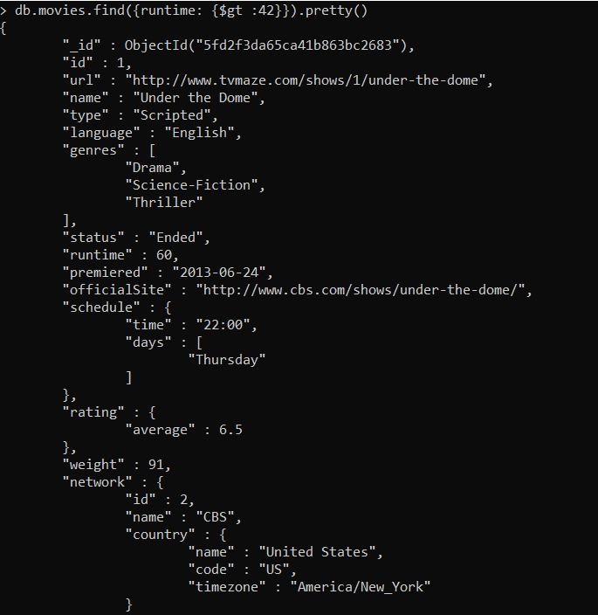
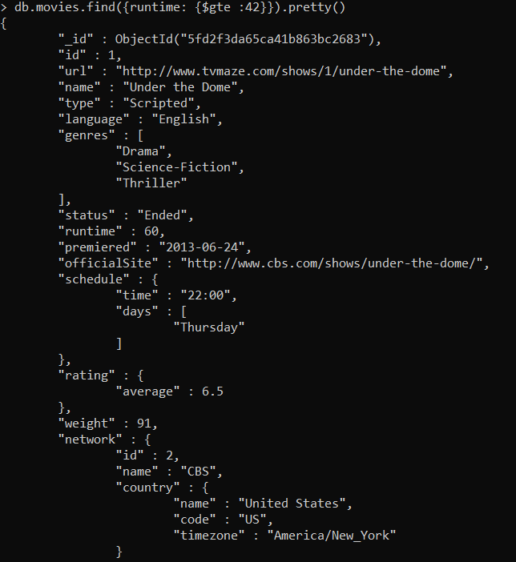
$gt and $gte

Slide 5
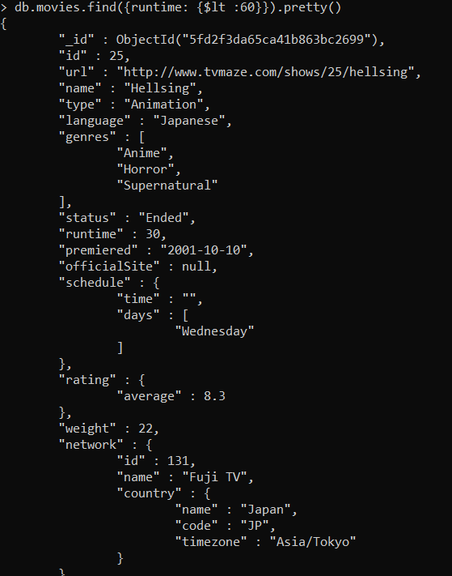

$lt and $lte

Slide 6
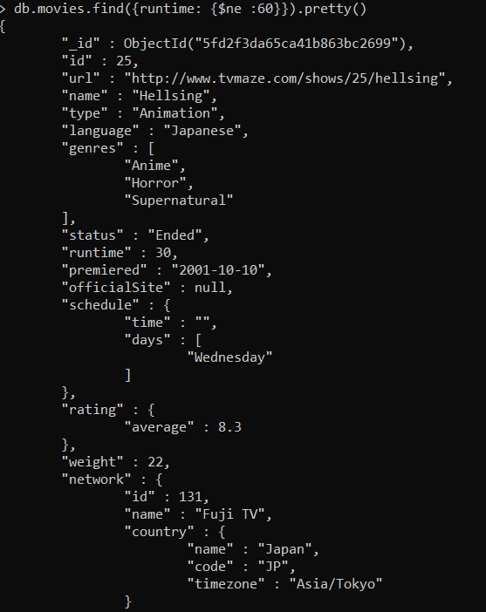
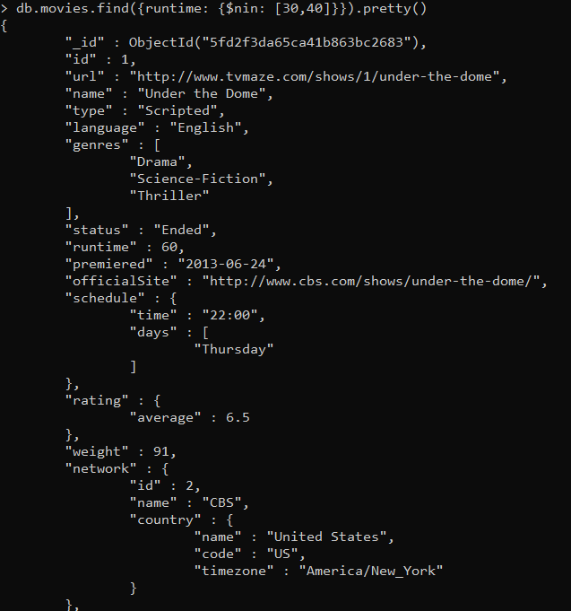
$ne and $nin

Slide 7
Logical Operators
Name | Description
$and | Joins query clauses with a logical AND returns all documents that match the conditions of both clauses.
$not | Inverts the effect of a query expression and returns documents that do not match the query expression.
$nor | Joins query clauses with a logical NOR returns all documents that fail to match both clauses.
$or | Joins query clauses with a logical OR returns all documents that match the conditions of either clause.

Slide 8
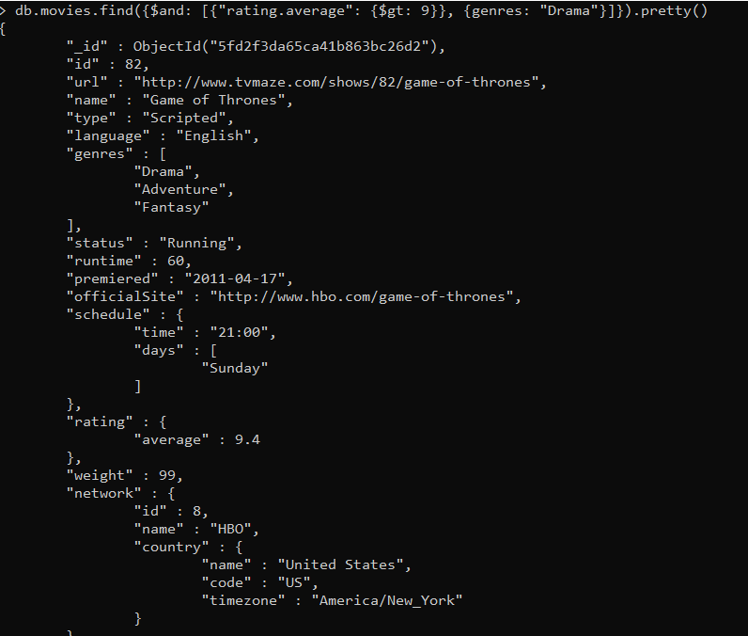
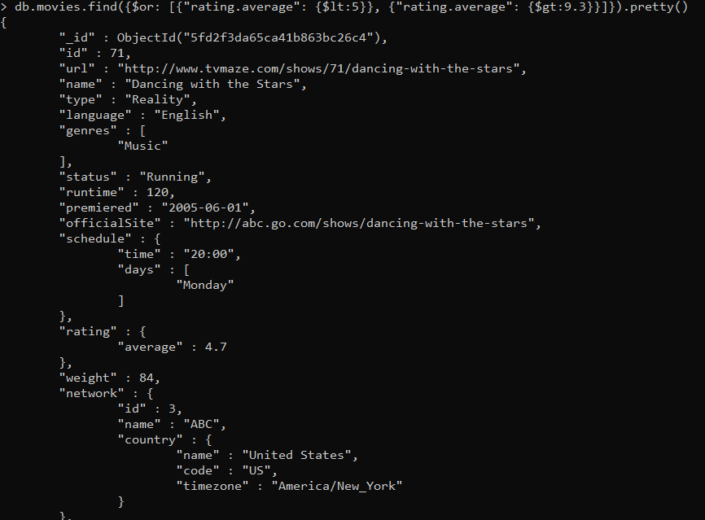
$and & $or

Slide 9
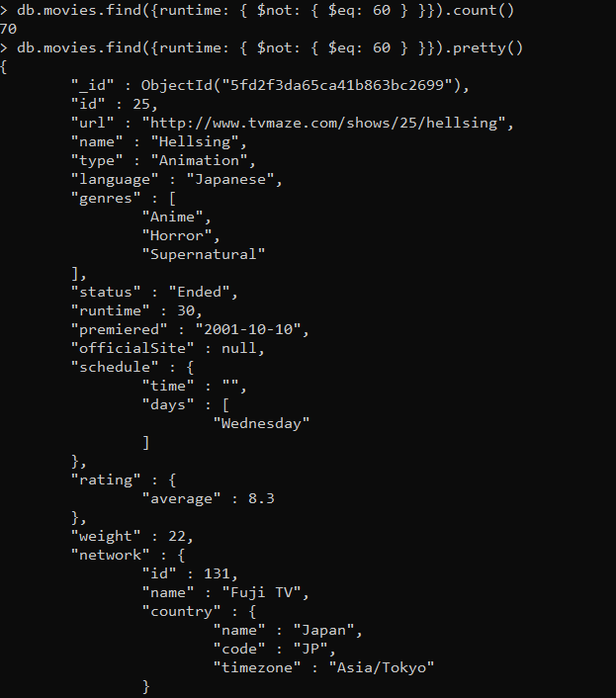
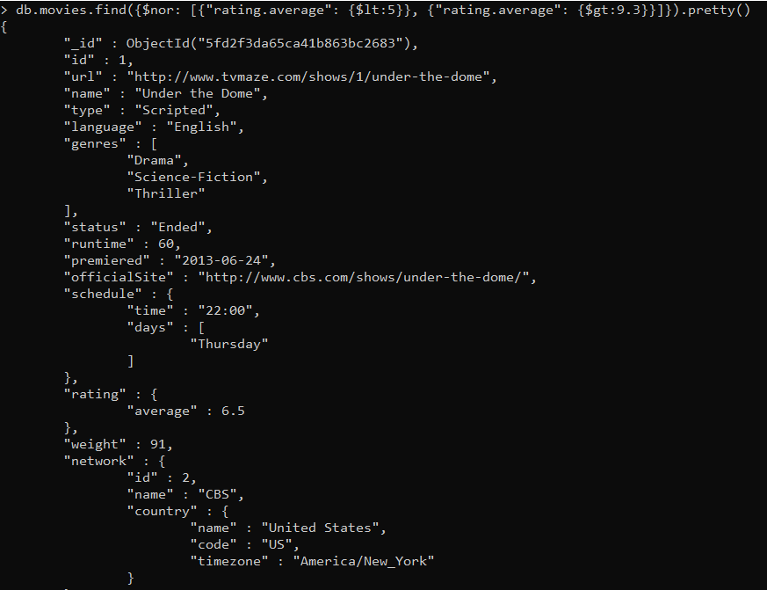
$not and $nor

Slide 10
Element Operators
Name | Description
$exists | Matches documents that have the specified field.
$type | Selects documents if a field is of the specified type.

Slide 11
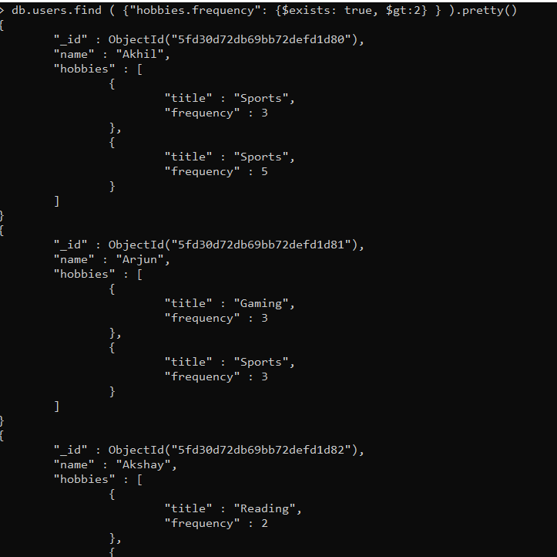
$exixts

Slide 12
Evaluation Operators
Name | Description
$expr | Allows use of aggregation expressions within the query language.
$jsonSchema | Validate documents against the given JSON Schema.
$mod | Performs a modulo operation on the value of a field and selects documents with a specified result.
$regex | Selects documents where values match a specified regular expression.
$text | Performs text search.
$where | Matches documents that satisfy a JavaScript expression.

Slide 13
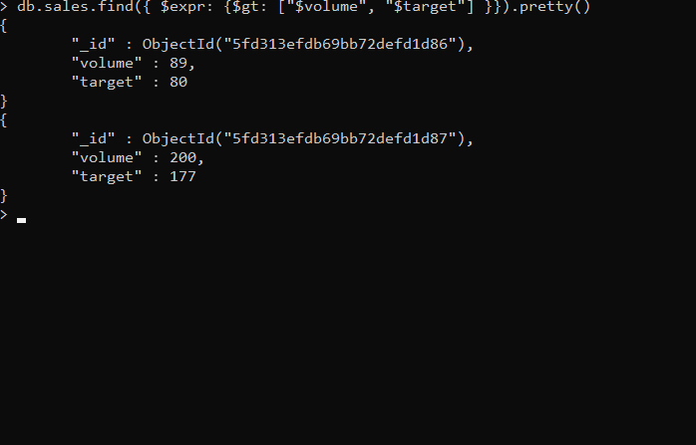
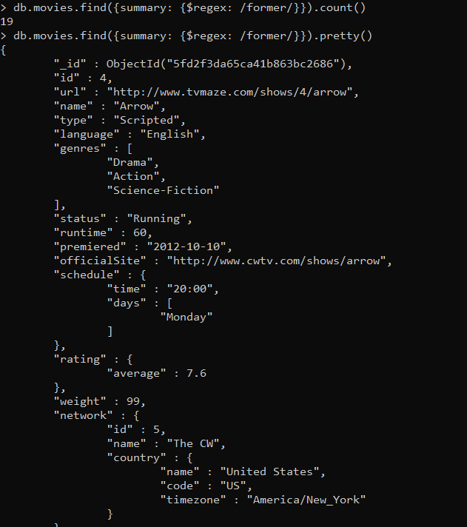
$expr and $rogex

Slide 14
Geospatial Operators
Name | Description
$geoIntersects | Selects geometries that intersect with a GeoJSON geometry. The 2dsphere index supports $geoIntersects.
$geoWithin | Selects geometries within a bounding GeoJSON geometry. The 2dsphere and 2d indexes support $geoWithin.
$near | Returns geospatial objects in proximity to a point. Requires a geospatial index. The 2dsphere and 2d indexes support $near.
$nearSphere | Returns geospatial objects in proximity to a point on a sphere. Requires a geospatial index. The 2dsphere and 2d indexes support $nearSphere.

Slide 15
Array Operators
$all | Matches arrays that contain all elements specified in the query.
$elemMatch | Selects documents if element in the array field matches all the specified $elemMatch conditions.
$size | Selects documents if the array field is a specified size.

Slide 16
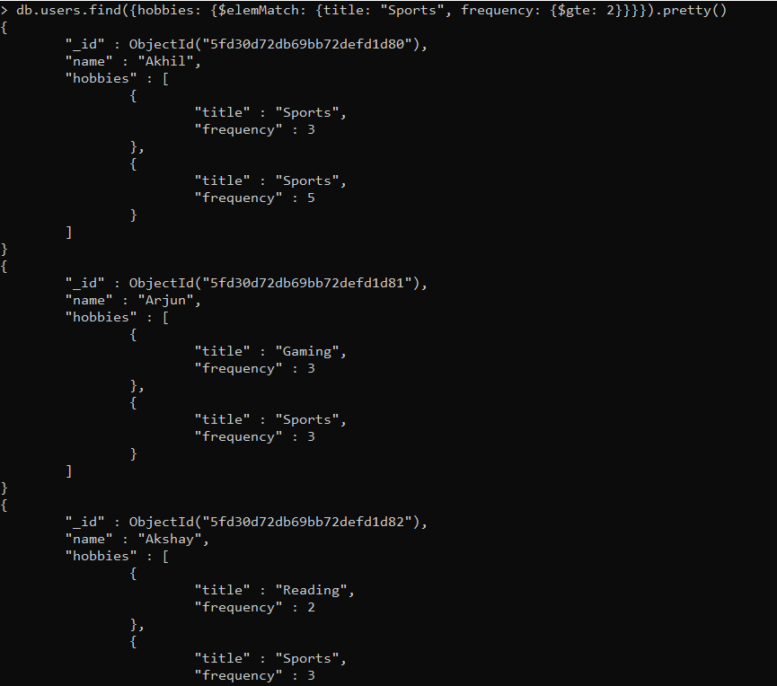
$elemMatch

Slide 17
Bitwise Operators
Name | Description
$bitsAllClear | Matches numeric or binary values in which a set of bit positions all have a value of 0.
$bitsAllSet | Matches numeric or binary values in which a set of bit positions all have a value of 1.
$bitsAnyClear | Matches numeric or binary values in which any bit from a set of bit positions has a value of 0.
$bitsAnySet | Matches numeric or binary values in which any bit from a set of bit positions has a value of 1.

Slide 18
Projection Operators
Name | Description
$ | Projects the first element in an array that matches the query condition.
$elemMatch | Projects the first element in an array that matches the specified $elemMatch condition.
$meta | Projects the document’s score assigned during $text operation.
$slice | Limits the number of elements projected from an array. Supports skip and limit slices.

Slide 19
Thank You!

